Slide 1
Live Session 6
By Ben Goodwin

Slide 2
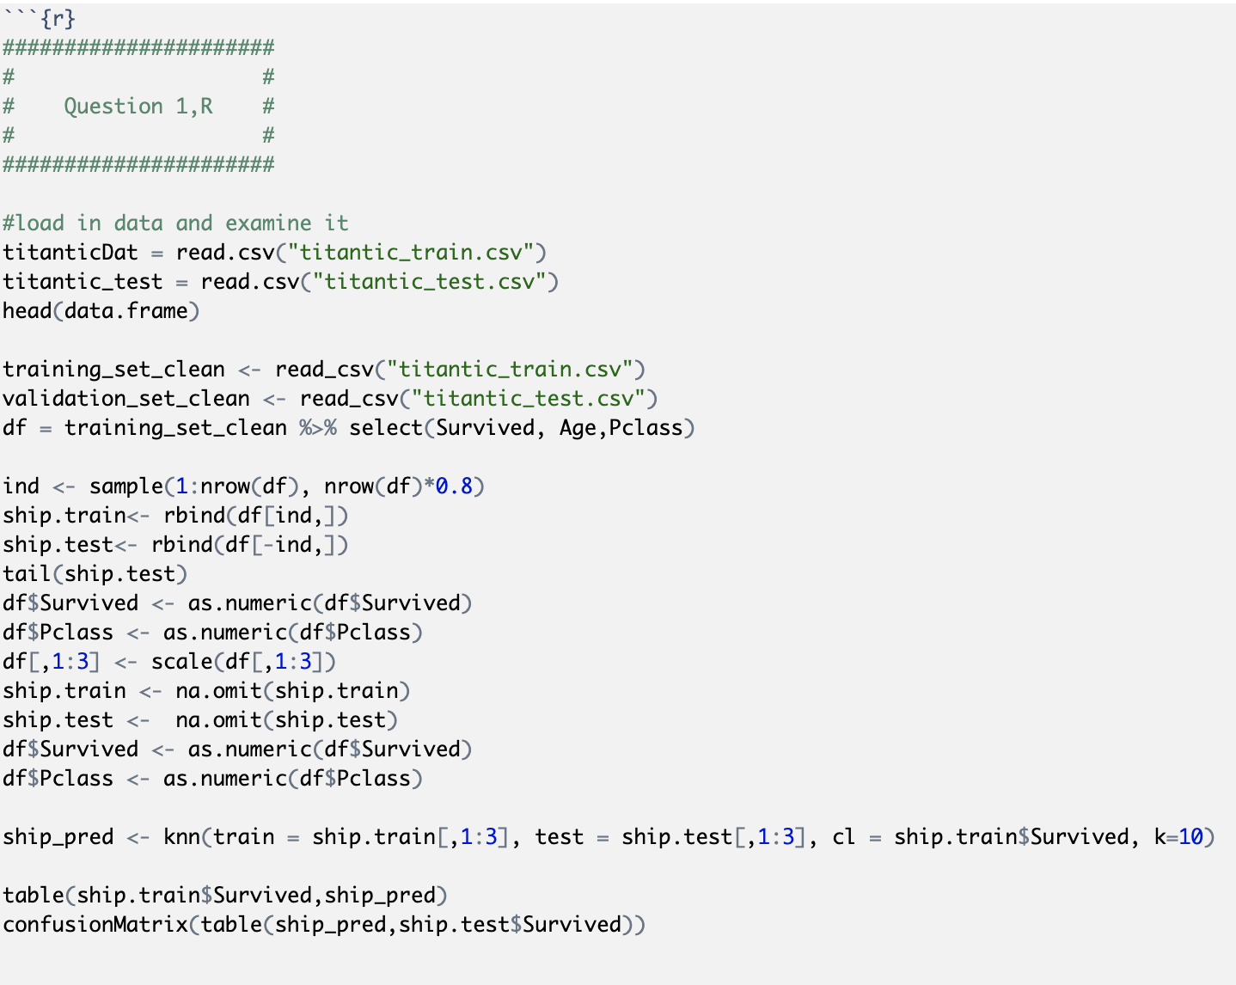
Question 1, Titanic Dataset
R input:

Slide 3
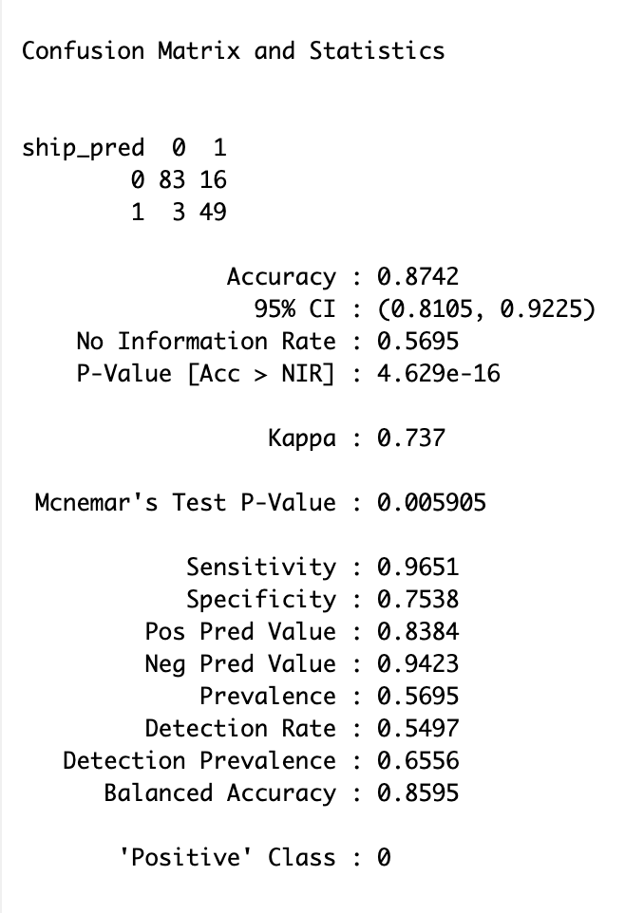
Question 1, Titanic Dataset
R output:

